Slide 1

Safeguarding
EVERYONE’s RESPONSIBILITY

Slide 2
Consideration
The session explores safeguarding roles and responsibilities and will touch upon issues of a sensitive nature.
Please be reminded of mutual care and respect

Slide 3
Today’s Objectives
To know and understand:
Your duties in respect of safeguarding legislation
Local context
Level of Need
Effective safeguarding practices - promote the welfare of children and protection from ‘significant harm’
How to manage disclosures (5 R’s)
What behaviours, disclosures and incidents to report

Slide 4
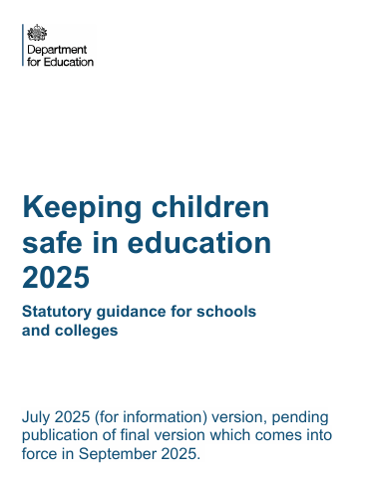
Essential Reading
Keeping children safe in education 2025
Part 1
Annex A
(Annex B)

Slide 5








Who is Jamie Ribolla?
Student well-being
Behaviour
Achievement
Curriculum
Standards

Slide 6
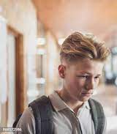
What would you do?
You are Ethan’s teacher. At the end of the lesson, he stays behind to tell you that mum and dad argue and shout a lot at home. Dad can get quite angry and slams and kicks doors. Mum cries. It upsets Ethan and his older brother, who has tried to talk to mum and dad about it, but the situation has not changed.

Slide 7
What is Safeguarding?
Safeguarding and promoting the welfare of children:
providing help and support to meet the needs of children as soon as problems emerge
protecting children from maltreatment, whether that is within or outside the home, including online
preventing the impairment of children’s mental and physical health or development
ensuring that children grow up in circumstances consistent with the provision of safe and effective care
taking action to enable all children to have the best outcomes
KCSIE(2025), para.3.
Child Protection (part of safeguarding practices), refers explicitly to:
Protect children identified as ‘suffering, or are likely to suffer, significant harm’.
Children Act (1989)

Slide 8

Facts and Myths
Teachers, school staff and parents are those responsible for safeguarding children.
Allegations of child abuse or neglect always lead to a criminal investigation.
The Children Act 1989 uses the concept of significant harm to justify compulsory intervention in family life.
Bullying and discrimination are the most common forms of harmful aggression experienced by children.
Children do not always tell the truth about their experience of neglect or abuse?
FALSE
FALSE
TRUE
TRUE
TRUE
FALSE

Slide 9
Facts and Myths
Particular groups of children are more likely to experience significant harm.
Physical Abuse is the most used category when a child is subject to a child protection plan.
Professionals, particularly schools, should operate a ‘no touch’ policy, to keep staff safe from allegations.
It is legal for a 15 year old to have consensual sex with a 19-year-old.
Personal attitudes and beliefs will influence judgements about a child’s needs and safety.
TRUE
FALSE
FALSE
FALSE
TRUE

Slide 10
Child Protection Plans by Abuse Category (England)
Protect a child(ren) who is suffering, or is likely to suffer, significant harm.
DfE (2025). Characteristics of children in need in England

Slide 11
Child Protection Plans by Abuse Category (Richmond)
109
106
92
96
161
150
110
95
134
COVID
To protect a child(ren) who is suffering, or is likely to suffer, significant harm.
DfE (2025). Characteristics of children in need in England

Slide 12
Referrals to Children’s Social Care Services (Richmond)
Child in Need
‘a child who is unlikely to achieve or maintain a reasonable level of health or development, or whose health and development is likely to be significantly or further impaired, without the provision of services; or a child who is disabled.’
(KCSIE, 2025, para.60)
COVID
DfE (2025) Characteristics of children in need in England

Slide 13
Children in Need Assessments (Richmond)
DfE (2025) Characteristics of children in need in England

Slide 14
‘It could happen here’
Safeguarding and promoting the welfare of children is everyone’s responsibility
Piecing the puzzle together - everyone has a role to play in identifying concerns, sharing information and taking prompt action.
All staff must be able to identify (Recognise) children who may benefit from early help.

Slide 15
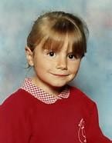
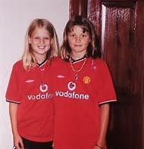
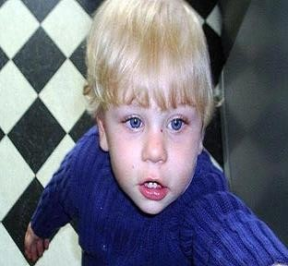
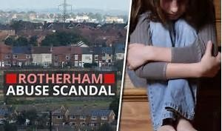

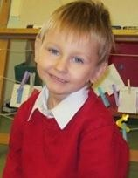
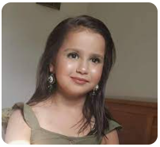
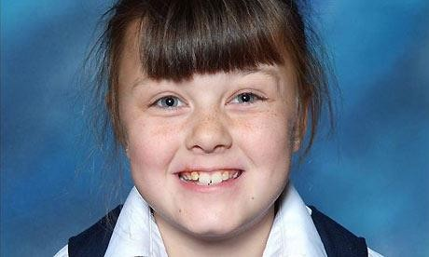
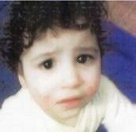
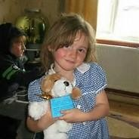
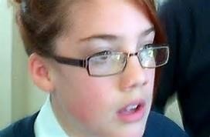
Why does safeguarding matter?
West Sussex 2000
Cambridgeshire 2002
Haringey London 2007
Rotherham 2016
Sandwell, 2021
West Yorkshire 2008
South London 2012
Bradford 2013
Powys, Wales 2012
Coventry 2013
Woking, 2023

Slide 16
Serious Case Reviews 2020-2023 Learning for improved practice around the education sector
‘Many case reviews highlighted education as a source of stability and continuity in children’s lives. Teachers were often identified as a positive relationship in the child’s life’ (NSPCC, 2023, p.2)
From your own experiences, what ‘failings’ or aspects of safeguarding practice do you think could be improved?
NSPCC (2023) Education: learning from case reviews

Slide 17
Serious Case Reviews 2020-2023 Learning for improved practice around the education sector
‘Many case reviews highlighted education as a source of stability and continuity in children’s lives. Teachers were often identified as a positive relationship in the child’s life’ (NSPCC, 2023, p.2)
Behaviour and attendance – are these indicators of safeguarding concerns?
Bullying – why is it taking place and what is impact is it having on children?
It can be hard to get children with SEND the help they needed.
Difficult to engage with, or effectively challenge, parents.
Difficult to get the information needed. Delays in sharing information.
Teachers are well placed to recognise and respond to abuse - ongoing concerns or changes in circumstances
Teachers need resources and knowledge to keep children safe online
In high-achieving schools, children are more worried about disclosing abuse
NSPCC (2023) Education: learning from case reviews

Slide 18
Key Documents
Keeping Children Safe in Education (2025) – part 1, Annex A, Annex B
‘Must’ and ‘Should’
Working Together to Safeguard Children (2023) – statutory guidance
What to Do if You’re Worried a Child is Being Abused: advice for practitioners (2015) – Gov advice

Slide 19
Keeping Children Safe in Education
Part 1 – All staff
Annex A – condensed version
Annex B – further info/support about specific abuse / safeguarding issues
Part 2 – Management of safeguarding
Part 3 – Safer Recruitment
Part 4 – Allegations made against teachers and other staff
Part 5 – Child on child sexual violence and harassment

Slide 20

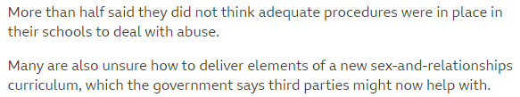
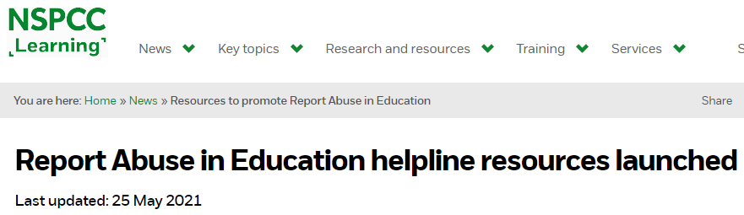
KCSIE – 2022 Updates
Reports of sex abuse between children double in 2 years (Sep 2021)
Child sexual abuse victims let down by ‘blatant hypocrisy and moral failing of religions’, inquiry finds (Sep 2021)
25% less investment in County Lines in rural locations (Aug 2021)

Slide 21
Review of Sexual Abuse in Schools and Colleges (June 2021)
‘It is concerning that for some children, incidents (of sexual harassment and online sexual abuse) are so commonplace that they see no point in reporting them’.
‘It shouldn’t be our responsibility to educate boys’
‘Professionals consistently underestimated the prevalence of online sexual abuse’.
‘Schools and colleges cannot tackle sexual harassment and sexual violence, including online, on their own, and neither should they’.
‘Schools must act as though sexual harassment, and online sexual abuse is happening – even if there are no reports’.

Slide 22
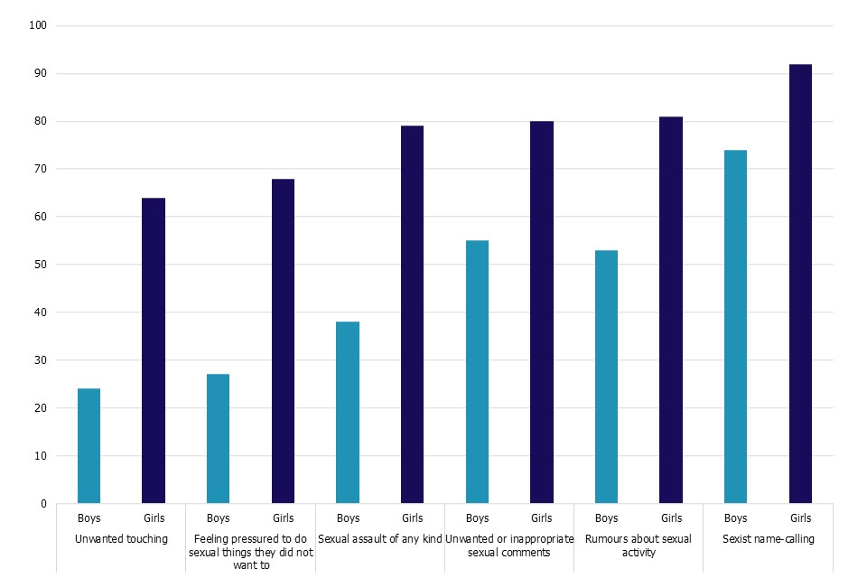
Fig.2. These things happen ‘a lot’ or ‘sometimes’ between people my age (%)

Slide 23






KCSIE – 2023 Updates
Online activity - schools to enhance monitoring of
Attendance – absence a warning sign of safeguarding concerns, including sexual abuse, sexual or criminal exploitation.
Safer Recruitment – online searches of job applicants
Application
Shortlisting
References
Selection / Interview

Slide 24
KCSIE – 2024 Updates
Categories of Abuse - previously 4 (physical, sexual, emotional and neglect) are now abuse, neglect and exploitation
Abuse can be indirect … ‘seeing, hearing, or experiencing effects of domestic abuse, are indicators of abuse’.
Gender questioning children guidance terminology

Slide 25
KCSIE – 2025 Updates
Revised guidance on RSHE – due summer 2025 and to be signposted in KCSIE updates
Online safety… 4 risks (content, contact, conduct, commerce). Conspiracy theories added as a content risk
Revised guidance on gender questioning – due summer 2025 and to be signposted in KCSIE updates
Child-on-child sexual violence and harassment. Link added to the Lucy Faithfull Foundation’s ‘Shore Space’ which offers a confidential chat service supporting young people concerned about their own or someone else’s sexual thoughts and behaviours.

Slide 26
What are my responsibilities?
To safeguard children and promote the welfare of children - extends beyond the education setting.
Be alert to indicators that something is not right before a child seeks help.
read part 1 and Annex A of Keeping Children Safe in Education
read key policies (safeguarding, behaviour / staff conduct)
know the safeguarding systems within your school
be alert to the potential need for Early Help for key vulnerable groups and know how to ‘raise concerns’
receive safeguarding training annually (provided by school)
know how to manage a disclosure (the 5 R’s)

Slide 27
Managing Disclosures
The 5 R’s

Slide 28
Recognise: ‘a child is vulnerable if he/she…’
is disabled or has certain health conditions and has specific additional needs
has SEND (whether or not they have a statutory Education, Health and Care plan)
has a mental health need
is a young carer
is showing signs of being drawn in to anti-social or criminal behaviour, including gang involvement and association with organised crime groups or county lines
is frequently missing/goes missing from education, home or care,
has experienced multiple suspensions, is at risk of being permanently excluded from schools, colleges and in Alternative Provision or a Pupil Referral Unit.
is at risk of modern slavery, trafficking, sexual and/or criminal exploitation
is at risk of being radicalised or exploited
has a parent or carer in custody, or is affected by parental offending
is in a family circumstance presenting challenges for the child, such as drug and alcohol misuse, adult mental health issues and domestic abuse
is misusing alcohol and other drugs themselves
is at risk of so-called ‘honour’-based abuse such as Female Genital Mutilation or Forced Marriage
is a privately fostered child.

Slide 29
Recognise
‘Children may not feel ready or know how to tell someone that they are being abused, exploited, or neglected, and/or they may not recognise their experiences as harmful’, (KCSIE, 2025, para.17).
‘Children may not find it easy to tell staff about their abuse verbally. Children can show signs or act in ways that they hope adults will notice and react to’, (KCSIE, 2025, para.471)
Domestic abuse – if children see, hear or experience abuse, which may be physical, emotional, economic, coercive and controlling behaviour.

Slide 30
Recognise: Early Help (Level 2)
‘Providing early help is more effective in promoting the welfare of children than reacting later’ (KCSIE, 2025, para.494).
‘Any child may benefit from early help, but staff should be particularly alert for a child who …’ (KCSIE, 2025, para.18).

Slide 31
Levels of Need and Support
1. Universal Services
2. Early Help
3. Targeted Help
4. Specialist Help
Parks
Doctors
Leisure Centres
Etc.
1 or 2 services
Lead practitioner (usually DSL, but could be…teacher, SENCO, GP, family support worker, etc.)
Team Around the Family (TAF) meeting
Early Help Assessment and plan
‘Unlikely to achieve or maintain a reasonable level of health or development, or whose health and development is likely to be significantly or further impaired, without the provision of services; or a child who is disabled.’
Lead practitioner to coordinate multi-agency approach
Reasonable cause to suspect a child is suffering or likely to suffer significant harm (Section 47 of the Children Act, 1989)
Child Protection Plan

Slide 32
What is Significant Harm? (Section 47 Enquiry)
Harm (Children Act 1989 section 31(9)):
ill-treatment (including sexual and physical abuse)
impairment of health (physical or emotional) or development (physical, intellectual, emotional, social or behavioural), including as a result of witnessing the ill-treatment of another person
Significant Harm - no absolute criteria.
The severity of ill-treatment depends on;
the degree and extent of harm
the duration and frequency of abuse and neglect
the extent of premeditation
the degree of threat and coercion, sadism and/or unusual elements
.

Slide 33
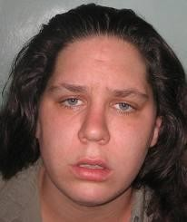
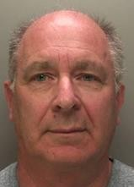
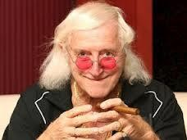
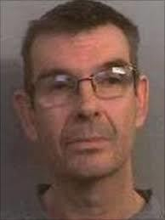

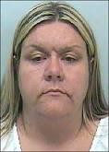
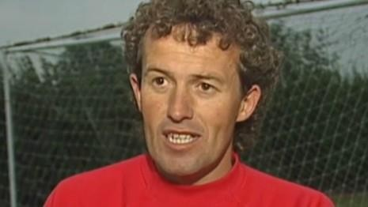

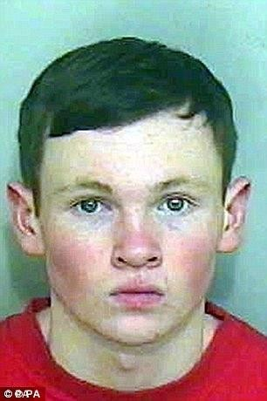
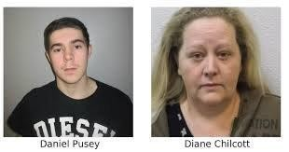
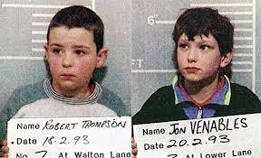
Significant Harm - who presents risk?
Jimmy Saville
Phillip Batten
RECOGNISE
Particular groups of children are more likely to suffer significant harm – disabled, babies, learning difficulties, disadvantaged
Vanessa George
Tracey Connelly
Rob Thomson
Nigel Leat
Parents/Carers
Celebrities / Staff
Strangers
Barry Bennell
Roy Whiting
Other Children
Lewis Daynes
Online

Slide 34
Abuse, Neglect and Exploitation
“Inflicting harm or failing to act to prevent harm”
abuse, neglect and safeguarding issues are rarely standalone events and cannot be covered by one definition or one label.
Report any concerns to DSL

Slide 35
Indicators of Abuse and Neglect
Physical
hitting, shaking, throwing, poisoning, burning or scalding, drowning, suffocating, a parent / carer fabricates the symptoms of, or deliberately induces, illness in a child.
Emotional
Child feels worthless, unloved, inadequate, used to meet the needs of another. No opportunities to express views, ‘made fun of’, age / developmentally inappropriate expectations, seeing or hearing the ill-treatment of another, bullying (including cyberbullying), feel frightened or in danger, or the exploitation or corruption of children.
Neglect
substance abuse during pregnancy. Failing to: provide adequate food, clothing and shelter, to protect a child from physical and emotional harm or danger; ensure adequate supervision, access to medical care or treatment. Ignore a child’s basic emotional needs.
Sexual
physical contact, penetration or non-penetrative acts such as masturbation, kissing, rubbing, and touching outside of clothing. Children in looking at, or in the production of, sexual images, watching sexual activities, encouraging children to behave in sexually inappropriate ways, or grooming a child in preparation for abuse.

Slide 36
Activity: Recognising Safeguarding Concerns
Beth
James
A’isha
Freddie
Potential Issue
Potential safeguarding issue – possible physical abuse
Potential issue
Potential safeguarding issue – possible radicalisation
Issue
Safeguarding Issue – possible sexual exploitation
Issue
Safeguarding issue – possible sexual abuse

Slide 37
Activity: Level of Need case studies
Sophie
Stephen
Maddison
Tim
Delayed speech, not engaged in play/learning, low income, poor state of housing
Level 2
Substance misuse (aged 12), inadequate parental care, possible domestic abuse
Level 3
Persistent behaviour issues, chronic absence, missing from home for long periods of time, situation worsening
Level 4
Level 1
All systems in place to support development.

Slide 38
Specific (Contextual) Safeguarding Issues (Annex B)
Child-on-child abuse - ''They told her they'd slit her throat'' - BBC London - YouTube
Child sexual exploitation (CSE) - ''They told her they'd slit her throat'' - BBC London - YouTube
Child criminal exploitation (CCE) - What is County Lines? - YouTube
Domestic Abuse - Domestic violence: The children affected - BBC News - YouTube
Female Genital Mutilation (FGM) - Female genital mutilation: the UK's hidden crime - YouTube
Mental health - Adverse Childhood Experiences (ACEs) - YouTube
Serious violence
Radicalisation - The young man who was radicalised until Prevent prised him away from the far-right extremists - YouTube

Slide 39
Specific (Contextual) Safeguarding Issues (Annex B - Full List)
Child abduction and community safety incidents
Child Criminal Exploitation (CCE) and Child Sexual Exploitation (CSE)
County lines
Children and the court system
Children who are absent from education
Children with family members in prison
Cybercrime
Domestic abuse
Homelessness
Mental health
Modern Slavery and the National Referral Mechanism
Preventing radicalisation
The Prevent duty
Channel
Sexual violence and sexual harassment between children in schools and colleges
Serious Violence
So-called ‘honour’-based abuse (including Female Genital Mutilation and Forced Marriage)
FGM
FGM mandatory reporting duty for teachers
Forced marriage
Additional advice and support
You must know the contextual safeguarding issues in your schools – speak to the DSL!

Slide 40
Specific Safeguarding Issues
Child Sexual Exploitation (CSE) and Child Criminal Exploitation (CCE) (both are abuse)
imbalance in power to coerce, manipulate or deceive a child into taking part in sexual or criminal activity
Usually in exchange for something the victim needs or wants, or increased status of the perpetrator through threat of violence
Girls experience often very different
CSE is sexual abuse and can be one-off or even unknown to victim (sharing of images). Includes 16- and 17-year-olds who gave consent to sex

Slide 41
Specific Safeguarding Issues
Female Genital Mutilation
Legal duty on teachers - must report to police
Other Honour-based abuse – Forced Marriage
Radicalisation and Extremism (Prevent)
We have a duty to prevent people being drawn into terrorism (Counter-terrorism Act 2015)
Extremism – ‘vocal or active opposition to fundamental British values, including democracy, the rule of law, individual liberty and mutual respect and tolerance of different faiths and beliefs.
Some children are at risk of being radicalised; adopting beliefs and engaging in activities which are harmful, criminal or dangerous - online and offline.

Slide 42
Other Safeguarding Issues
Child on Child abuse
Even if there are no reports, does not mean it is not happening
Importance of challenging inappropriate behaviour. Sexual harassment – ‘just banter’, ‘boys being boys’ – creates an unsafe environment and normalises abusive behaviour
Bullying
Abuse within intimate relationships
Physical abuse
Sexual violence
Sexual harassment
Sexual activity without consent
Sharing of images
Up-skirting
Bullying, cyberbullying and discrimination are the most common forms of harmful aggression experienced by children

Slide 43
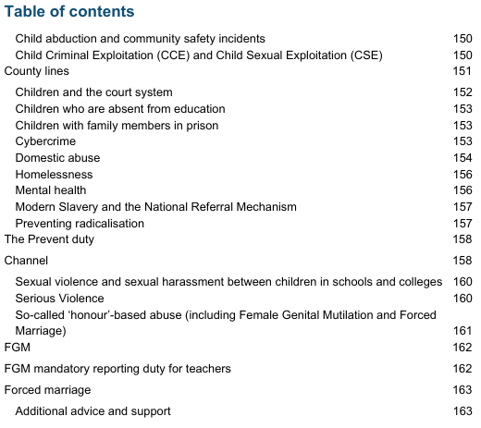
Additional Information and Support
What to Do if You Are Worried a Child is Being Abused - Advice for Practitioners
Annex B

Slide 44
Online Safety – Supporting links
Organisation | Supporting Link
NSPCC resources and guidance | https://www.nspcc.org.uk/preventing-abuse/keeping-children- safe/online-safety/
CEOP | https://www.thinkuknow.co.uk/
UK Safer Internet Centre | https://saferinternet.org.uk/ NSPCC Sexting advise www.nspcc.org.uk/preventing-abuse/keeping-children-safe/sexting/
New UK Council for Child Internet Safety (UKCCIS) | https://www.gov.uk/government/news/new-council-for-internet-safety- in-the-uk and guidance on Sexting
Childnet | www.childnet.com/resources
Parent Zone | https://www.parentzone.me/

Slide 45
Mini-Plenary
Overwhelmed!! … Is this a safeguarding issue? … Do I speak to the child / parent? … What do I do?
Safeguarding is everyone’s responsibility
KCSIE (2025)
Know my school context
Early Help / Level of Need
Managing Disclosures – the 5 Rs (recognise)

Slide 46
Respond to Disclosures
Beth is known for being an inquisitive and chatty member of the class. Recently, however, you have noticed a complete change in her behaviour. For the last couple of weeks, Beth has been much quieter and withdrawn. You also notice that although it is a very hot summer and Beth wore dresses a few weeks ago, she has recently been consistently wearing clothes that cover her whole body.
Beth approaches you and asks if she can talk to you about something.
How do you respond?

Slide 47
Managing Disclosures – the 5 R’s
Recognise
Respond
R…
R…
R…
Know the vulnerable groups (Early Help)
Signs / symptoms
Do not investigate
Let them tell their story – ‘TED’
Open, non-leading questions… contaminate evidence
Reassure / supportive
Must pass on

Slide 48
Responding to Disclosures
‘Children may not feel ready or know how to tell someone that they are being abused, exploited, or neglected, and/or they may not recognise their experiences as harmful’, (KCSIE, 2025, para.17).
‘Children may not find it easy to tell staff about their abuse verbally. Children can show signs or act in ways that they hope adults will notice and react to’, (KCSIE, 2025, para.471)
Children are no more likely to mislead than adults, particularly in relation to abusive incidents (Spence & Flyn 1990).
4th disclosure!!
Children may retract allegations – this does not discredit the allegation.
Never examine a child or ask them to show you bruises, etc.
Empathy – but do not touch / pat / hug – different meaning to victim of abuse
We must always take a child seriously.

Slide 49
Record a Disclosure
Take notes – but check the child is comfortable with this
Written record (ideally within 1hr). Can become court evidence.
Clear, comprehensive summary of the concern
What the child said (their language), your responses, emotional context, repeated statements, environment disclosure was made (date, time, location, others present)
Details of how concern was followed up
Who reported to? When? How?
Note of any action taken, decisions reached and the outcome.
Did you agree to contact home, DSL, get back to the child, when?

Slide 50
Managing Disclosures – the 5 R’s
Recognise
Respond
Record
Refer
Report
Know the vulnerable groups (Early Help)
Signs / symptoms
Do not investigate
Let them tell their story – ‘TED’
Open, non-leading questions… contaminate evidence
Reassure / supportive
Must pass on
In writing
Full detail
Child’s language
To the Designated Safeguarding Lead
The DSL will refer to the appropriate service, based on perceived level of need.

Slide 51
Reporting / Referring Concerns
Early Help – DSL to liaise with other agencies as required. If the situation does not improve…
Refer to Local Authority – provide as much information as possible, including whether harm is taking place outside of the home.
Single Point of Access - London Borough of Richmond upon Thames
Report child abuse to a local council - GOV.UK (www.gov.uk)
Children in Need – Local Authorities required to provide services to support (section 17 of the Children Act 1989)
Significant Harm – a duty to make enquiries under Section 47 of the Children Act 1989.

Slide 52
Why does safeguarding matter?
West Sussex 2000
Cambridgeshire 2002
Haringey London 2007
Rotherham 2016
Sandwell, 2021
West Yorkshire 2008
South London 2012
Bradford 2013
Powys, Wales 2012
Coventry 2013
Woking, 2023

Slide 53
Poor Practice (Serious Case Reviews)
Prevents / delays the appropriate support reaching the child – may allow significant harm to continue
failing to act on and refer the early signs of abuse and neglect
poor record keeping;
failing to listen to the views of the child;
failing to re-assess concerns when situations do not improve;
not sharing information with the right people within and between agencies;
sharing information too slowly; and
a lack of challenge to those who appear not to be taking action

Slide 54
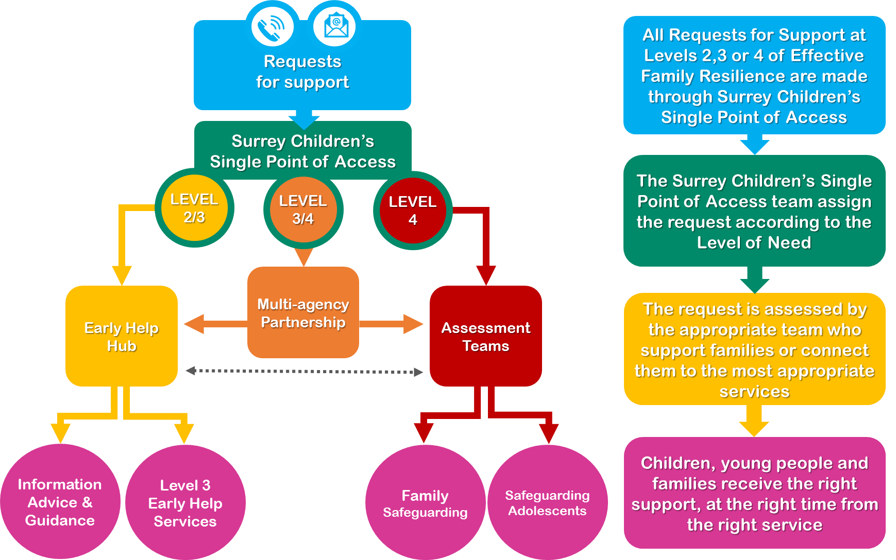
Referring Disclosures (C-SPA)
When making a referral…
What are you seeking from this referral?
What is the Level of need / risk?
Is there serious risk of harm?
Is consent needed?

Slide 55
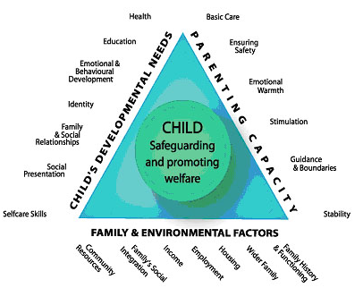
Assessment Framework Triangle

Slide 56
Referrals of Significant Harm
Case referred to LA Children’s Services
Section 47 Outcome:
Concerns about child’s immediate safety
Further assessment needed
No LA support or involvement required
If other actions necessary, Early Help Assessment
Referral acknowledged
Section 47: Assessment
Share all info relating to Child & Family
Initial Child Protection Conference
Child Protection / Child in Need Plan
Section 47: Assessment
Consider causes, strengths/weaknesses of family, evaluate risks and intervention
Core Groups followed by review processes

Slide 57
Child Protection Conference
SHARE - Confidential meeting between parents, children services, child protection workers and other professionals to discuss the welfare of a child(ren)
ASSESS - the likelihood of the child suffering significant harm in the future.
NEXT STEPS - what future action is required to safeguard and promote the welfare of the child/children with planned developmental outcomes.
Meetings can be:
Initial – within 15 days of strategy meeting
Review – first within 3 months and then every 6
Unborn child – from 3 months to birth

Slide 58
The Child Protection Plan
Identifies needs of the child and support required to safeguard and promote the welfare of the child.
Necessary actions to achieve this
Identifies everyone’s roles and responsibilities.
Sets out a timeframe – including visits by social worker, who becomes the lead professional (visits must be every 10 days)
Family develop and contribute to the plan
Announced visits by other professionals
Is written in clear way and includes a contingency plan

Slide 59
Review of the Child Protection Plan
Core Group
multiple agencies responsible for reviewing and further developing the plan – what next steps are required and by whom?
Reviews must take place 10 days after conference, at 6 weeks and then every 2 months
Review Conference – is the child continuing to suffer, or likely to suffer, significant harm?
review progress against planned outcomes
Ensure child remains safeguarded
Should CP Plan continue or be stepped down to Child in Need plan

Slide 60
What Next? Public Law Outline and Care Proceedings
Legal Gateway meeting - plan not working. Child remains at risk of significant harm
Letter of intent to explain to parents the concern/s, what needs to change with clear timescales, actions that will happen and advising the parents that a meeting will take place with parents (who have the right to free legal representation).
Possible care proceedings and removal of the child to a safe place which may be with friends and family, foster care or a residential unit.

Slide 61
How will today’s session influence your future practice?

Slide 62
What would you do?
You are Ethan’s teacher. At the end of the lesson, he stays behind to tell you that mum and dad argue and shout a lot at home. Dad can get quite angry and slams and kicks doors. Mum cries. It upsets Ethan, and his older brother, who has tried to talk to mum and dad about it, but the situation has not changed.

Slide 63
References / Resources
Barnardo's. Believe in children | Children’s charity. [online] Barnardo’s. Available at: https://www.barnardos.org.uk/.
Department for Education, (2022). Keeping children safe in education. London: Department for Education
Healthysurrey.org.uk. (2021). [online] Available at: https://www.healthysurrey.org.uk/domestic-abuse
H M Government, (2018). Working together to safeguard children. London: H M Government
H M Government, (2015). What to do if you’re worried a child is being abused. Advice for practitioners. London: H M Government
H M Government, (2018). Information Sharing: Advice for Practitioners providing safeguarding services to children, young people, parents and Carers. London: H M Government
NSPCC. [online] NSPCC. Available at: https://www.nspcc.org.uk/
Surrey Safeguarding Children Partnership. [online] Available at: https://www.surreyscp.org.uk/.
SSCP (2020). Effective Family Resilience. Available at: Effective-family-resilience-SSCP-Dec-2020-v7.pdf (surreyscp.org.uk)

Slide 64
Essential Supporting Videos
Safeguarding: Sharing of Information - Sharing of Information July 2019 - YouTube
Safeguarding: Defining Child Abuse - Safeguarding Defining Child Abuse v2 - YouTube
Safeguarding: The Hidden Face - Safeguarding: The Hidden Face - YouTube
Safeguarding: Procedures - Safeguarding: Procedures - YouTube
Safeguarding: Disclosure - Safeguarding: Disclosure - YouTube
Safeguarding: Recording - Safeguarding: Recording - YouTube
Safeguarding: Referrals - Safeguarding: Referrals - YouTube

Slide 65
Additional Supporting Videos
Safeguarding: types and forms of abuse - Safeguarding: Types and Forms of Abuse - YouTube
Safeguarding: Physical - Safeguarding: Physical - YouTube
Safeguarding: Emotional - Safeguarding: Emotional - YouTube
Safeguarding: Sexual - Safeguarding: Sexual - YouTube
Safeguarding: Neglect - Safeguarding: Neglect - YouTube
Safeguarding: Forced Marriage - Safeguarding: Forced Marriage - YouTube
Safeguarding: FGM - Safeguarding: FGM - YouTube
Safeguarding: The Prevent Duty - Safeguarding: The Prevent Duty - YouTube
Safeguarding: Bullying - Safeguarding: Bullying - YouTube
Safeguarding: LGBTQ Awareness - Safeguarding: LGBTQ Awareness - YouTube
Safeguarding: Post Referrals - Safeguarding: Post Referrals - YouTube

Slide 66
Today’s Objectives
To know and understand:
Your duties in respect of safeguarding legislation
Local context
Level of Need
Effective safeguarding practices - promote the welfare of children and protection from ‘significant harm’
How to manage disclosures (5 R’s)
What behaviours, disclosures and incidents to report

Slide 67
QUESTIONS

